Slide 1
LECTURE # 02 PYTHON PACKAGES
ARTIFICIAL INTELLIGENCE

Slide 2
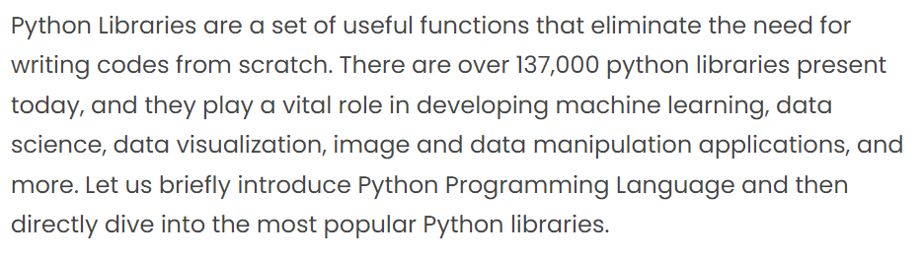
WHAT ARE PYTHON libraries?

Slide 3
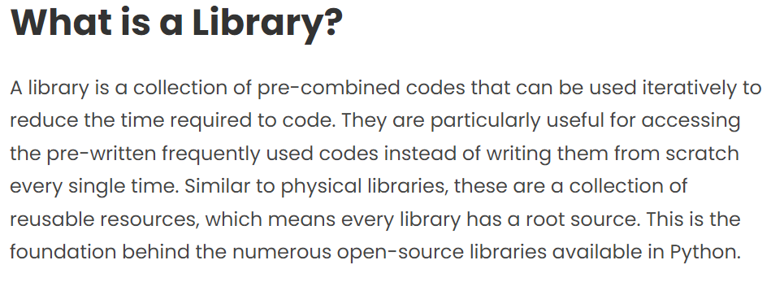

Slide 4
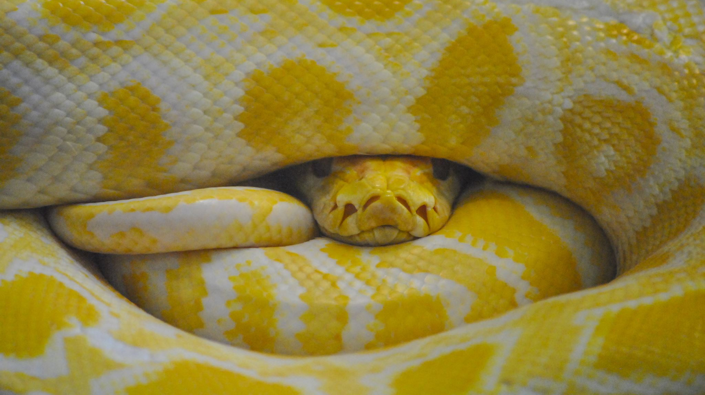


HOW TO INSTALL PYTHON PACKAGES python packages are installed using pip pip: python installable packages

Slide 5


Slide 6
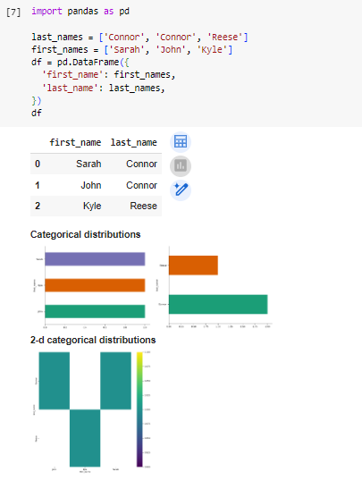
PANDAS DATAFRAME

Slide 7
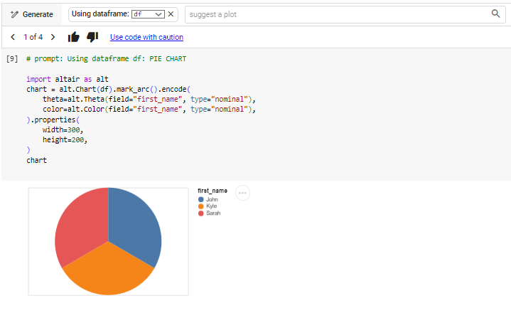
GENERATE ANY KIND OF CHART SUITABLE TO YOUR DATASET

Slide 8
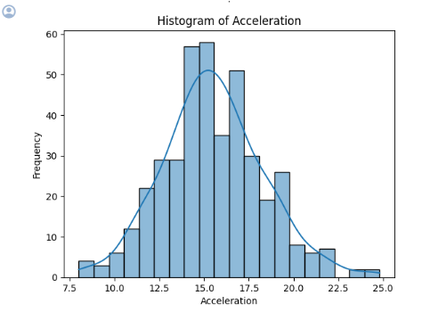
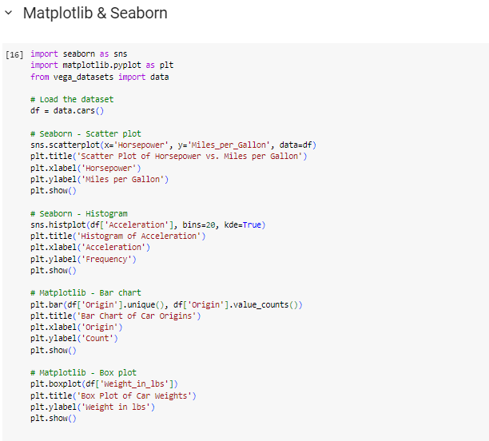
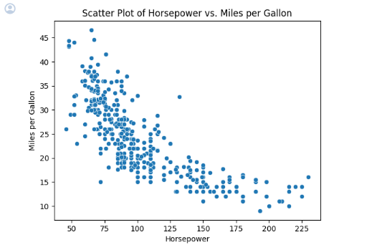
Matplotlib and seaborn

Slide 9
Plotly:
Plotly is a Python library for creating interactive and publication-quality plots and visualizations. It supports a wide range of chart types, including scatter plots, line charts, bar charts, heatmaps, and more. Plotly allows users to create dynamic and interactive plots with features such as zooming, panning, tooltips, and hover information. It is often used for data exploration, analysis, and presentation in fields such as data science, finance, and engineering.

Slide 10
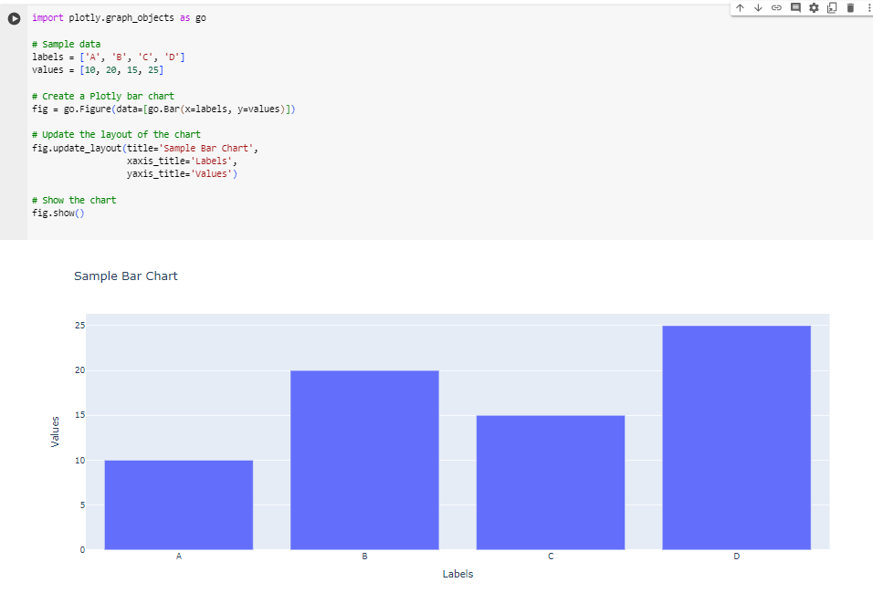
Plotly:

Slide 11
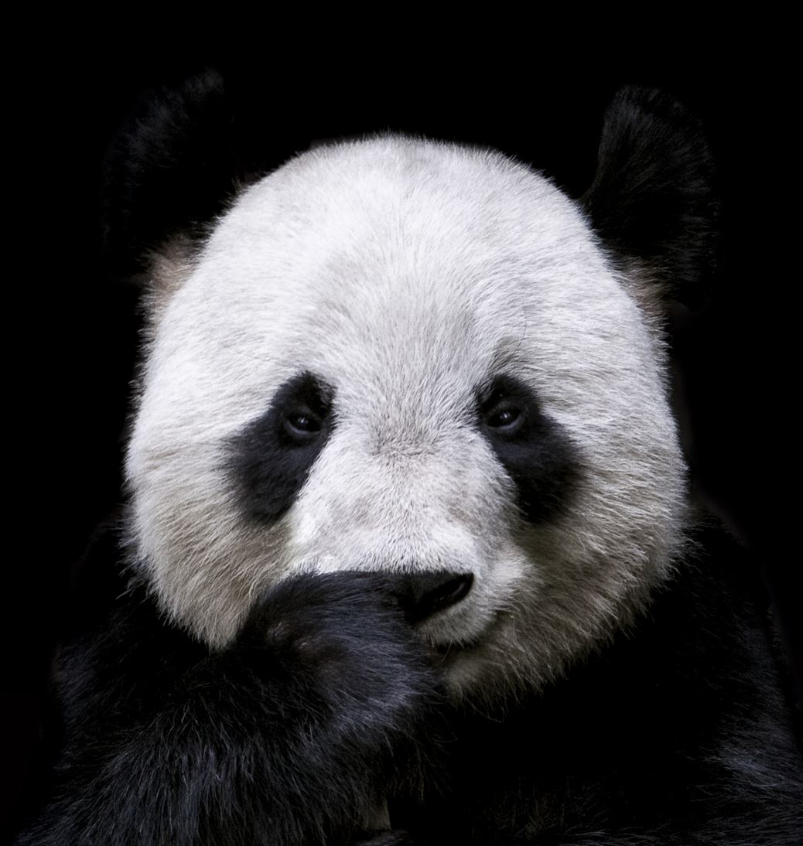


PANDAS AI
Pandas AI is not a standard library or tool within the Python ecosystem. It seems that the term "Pandas AI" is referring to the combination of using the popular Pandas library in Python for data manipulation and analysis, along with artificial intelligence (AI) techniques such as machine learning or deep learning.

Slide 12
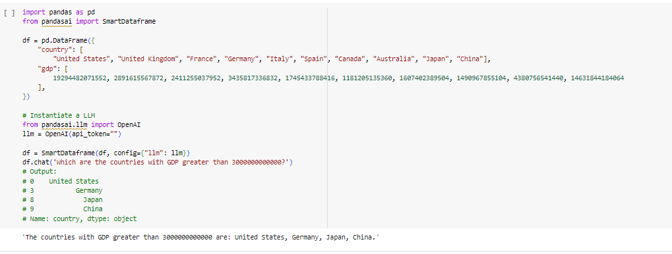
Pandas ai

Slide 13

OpenCV
OpenCV (Open-Source Computer Vision Library) is a popular open-source computer vision and machine learning software library. It provides a wide range of tools and algorithms for image and video processing, including object detection, facial recognition, motion tracking, and image segmentation.

Slide 14
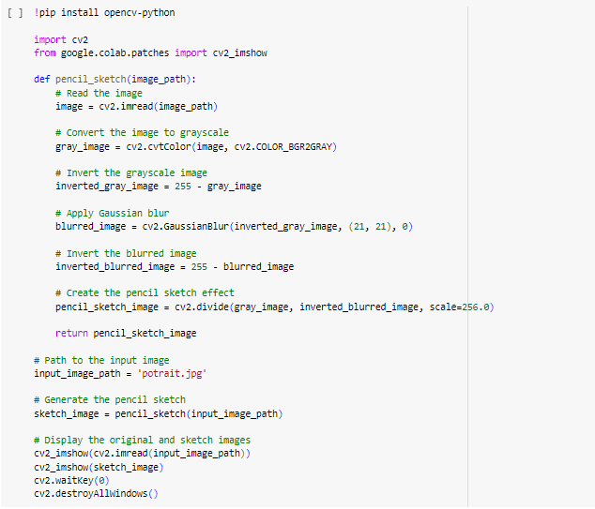

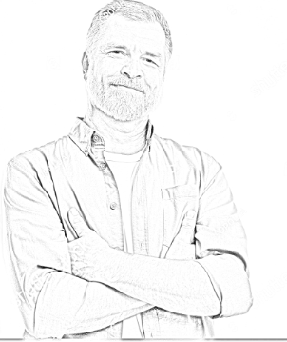
Picture to sketch using OpenCV

Slide 15
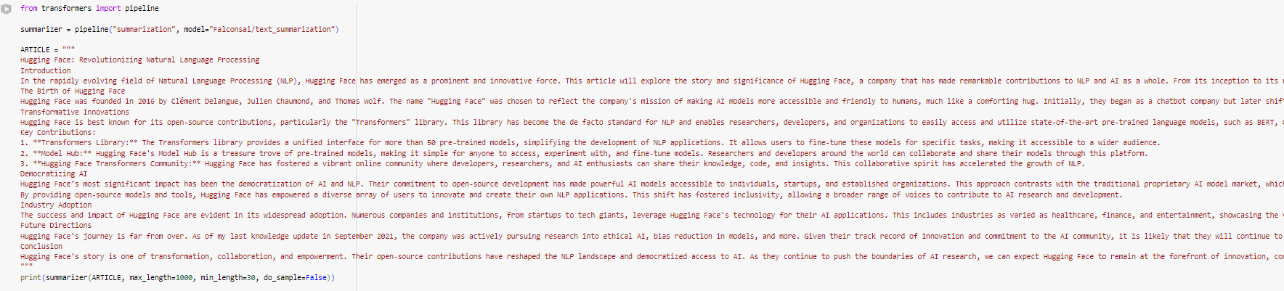
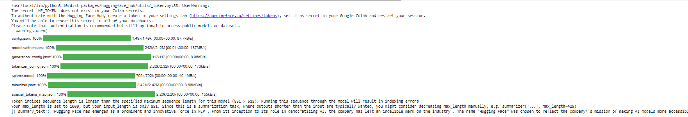
Transformers: text summarization model

Slide 16
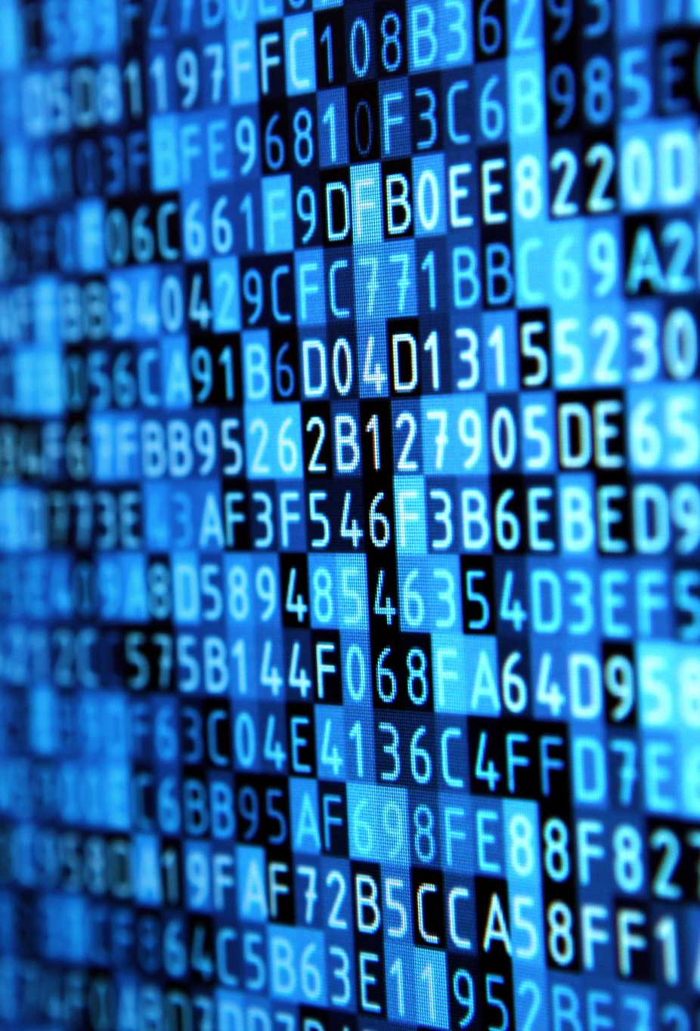
Beautiful soup
Beautiful Soup is a Python library used for web scraping, which is the process of extracting data from HTML and XML documents. It provides functions and methods to navigate and search the parse tree created from the HTML or XML content, making it easy to extract specific information such as text, links, and tags from web pages.

Slide 17
pywhatkit
Pywhatkit is a Python library that provides various utility functions for tasks such as sending WhatsApp messages, searching for information on the web, playing YouTube videos, converting text to handwriting, and more.
With pywhatkit, you can automate simple tasks and interact with web services using Python code. It simplifies common tasks and provides an easy-to-use interface for performing actions such as sending messages or emails, fetching data from websites, and controlling media playback.

Slide 18
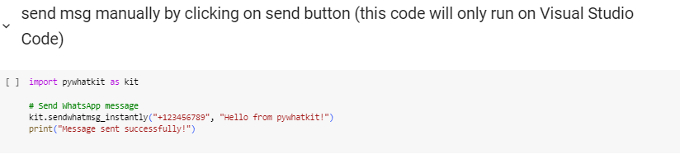
Send msg manually

Slide 19
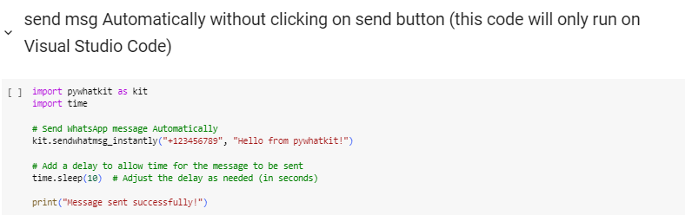
Send msg automatically

Slide 20
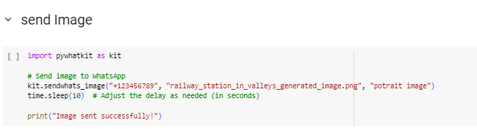
Send image

Slide 21
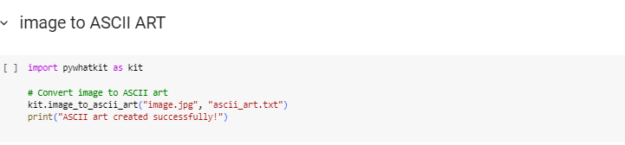
Image to ascii art

Slide 22
pyttsx3
pyttsx3 is a Python library for text-to-speech (TTS) conversion. It allows you to convert text into spoken words using different speech engines installed on your system. The library provides a simple and easy-to-use interface for generating speech from text in Python scripts.
With pyttsx3, you can create applications that read out text content aloud, which can be useful for accessibility purposes, creating interactive voice-based applications, or adding speech functionality to your projects.

Slide 23
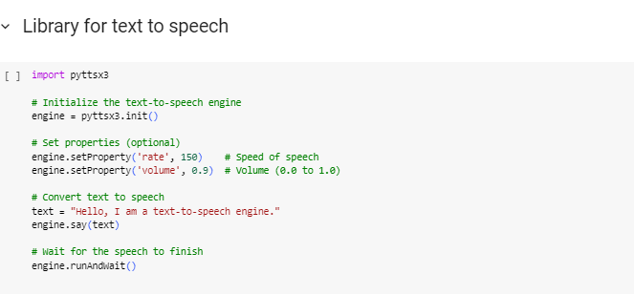
Library for text to speech

Slide 24
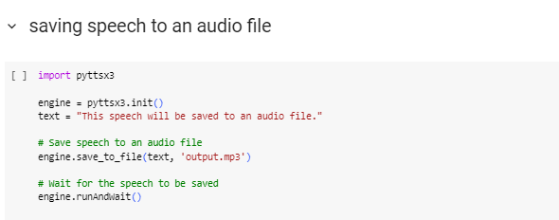
Saving speech to an audio file

Slide 25
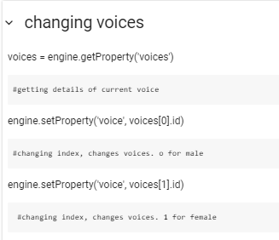
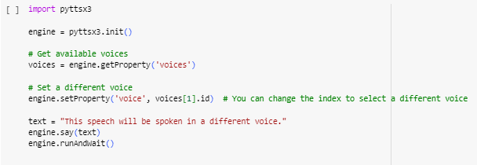
Changes voice

Slide 26

Request package
The requests package in Python is used to send HTTP requests to web servers and retrieve data from web pages or web APIs. It simplifies the process of making HTTP requests and handling responses, making it easier to interact with web services in Python scripts.

Slide 27
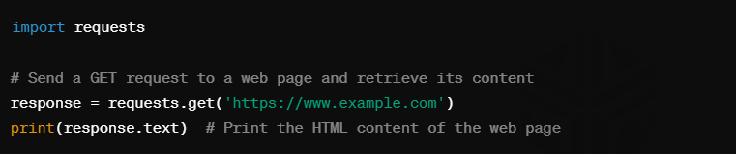
Retrieve web page content

Slide 28

Tasks: 1
Task 1: Develop a Python application to generate data visualizations Scenario: You are a data analyst working with a large dataset containing various types of data. Your task is to create a Python application that uses the Pandas, Matplotlib, and Seaborn libraries to perform exploratory data analysis and generate interactive visualizations. The application should allow users to load their dataset, explore the data, and create suitable charts and plots for visual analysis.

Slide 29

Tasks: 2
Implement a text summarization model using Transformers Scenario: As a natural language processing (NLP) researcher, you have been tasked with developing a text summarization model that can generate concise summaries of long text documents. Your task is to utilize the Transformers library in Python to build and train a summarization model. The model should be able to take a long text document as input and generate a concise summary that captures the key information and main ideas.

Slide 30

Tasks: 3
Convert images to sketches using OpenCV Scenario: You are a computer vision enthusiast working on a project to develop a photo editing application. Your task is to create a Python script that uses the OpenCV library to convert regular images into sketches. The script should allow users to select an image file, apply appropriate filters and transformations to convert it into a sketch-like image, and save the resulting image to disk.

Slide 31

Tasks: 4
Build a web scraper using Beautiful Soup Scenario: You are a data engineer working for Pakveels. Your task is to develop a Python script that uses the Beautiful Soup library to scrape product information from competitor websites. The script should be able to extract data such as product names, descriptions, prices, and images from the target websites and store the data in a structured format (e.g., CSV or JSON) for further analysis.

Slide 32
Tasks: 5
Automate WhatsApp messaging using PyWhatKit Scenario: You are a software developer working on a project to automate communication for a small business. Your task is to create a Python script that uses the PyWhatKit library to automate the sending of messages and images through WhatsApp. The script should allow users to schedule the sending of messages or images to one or more contacts at specific times or intervals.

Slide 33

Tasks: 6
Develop a text-to-speech application using pyttsx3
Scenario: You are a developer working on an accessibility project to help visually impaired users interact with digital content. Your task is to create a Python application that uses the pyttsx3 library to convert text into spoken words. The application should allow users to input text, select voice settings (e.g., language, gender, rate), and generate audio output that can be played or saved to a file.

